Slide 1
Chapter:5
DC Machine

Slide 2
Introduction
DC machine is an electromechanical energy alteration device
DC machine that converts mechanical power to electrical power are Generators, where as a DC machine that converts electrical power to mechanical power are Motors
DC machine is most frequently used for a motor
The main benefits of this machine include torque regulation as well as easy speed regulation.
The applications of the DC machine is limited to trains, mills, and mines
For example, underground subway cars, as well as trolleys, may utilize DC motors. In the past, automobiles were designed with DC dynamos for charging their batteries

Slide 3
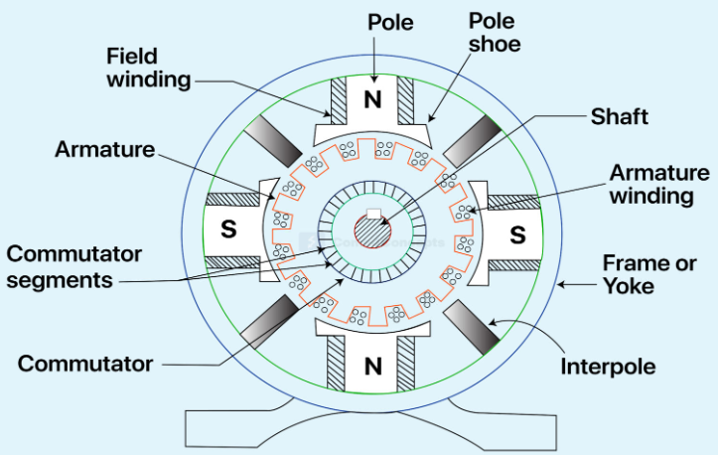
Construction of DC machines(Generator and Motor)

Slide 4
1. Yoke (Magnetic Frame)
The outer frame or yoke serves a double purpose
It provides mechanical support for the poles and acts as a protecting cover for the whole machine
It carries the magnetic flux produced by the poles
yokes are made of cast iron or steel
2. Field system(Stator)
Stator is the stationary part of the machine
Its main function is to provide main magnetic flux in which armature coil rotates.
It consists of poles and pole shoes
Pole core and Pole Shoes
The field magnets consist of poles (north south poles of magnet) and pole shoes.
The pole shoes serve two purposes:
they spread out the flux in the air gap
they support the exciting coils (or field coils)

Slide 5
Field windings
It is the winding that produces main flux in the machine.
Field winding is applied to stator.
These windings are wound on poles in such a way that whenever current passes through it they act like electromagnet.
2. Armature System(Rotor)
Rotor is the basic part of DC machine.
It consists of armature core, armature winding and commutator.
Armature
It is the rotating part of dc machine.
It is cylindrical in shape.
It consists of core that is laminated to reduce eddy current loss.
Core slots are also present that holds armature windings

Slide 6
Armature windings
These are the conductor winding placed in the slots provided in the armature core.
When armature core rotates, EMF is induced in the armature winding.
Coil ends of armature windings are connected to commutator segments.
3. Commutator
It is a mechanical rectifier used for obtaining a rectified waveform at the output in order to get dc voltage.
It is responsible to supply current to the load through brushes.
The commutator is made of copper segments insulated from each other by mica sheets and mounted on the shaft of the machine.
4. Brushes
It helps to gather the current from the commutator and supply it to the exterior load.
It acts as a contact.

Slide 7
DC Generator
It is an electromechanical energy conversion device that converts mechanical power into DC electrical power through the process of electromagnetic induction.
A DC generator operates on the principle of electromagnetic induction
When the magnetic flux linking a conductor changes, an EMF is induced in the conductor.
A DC generator has a field winding and an armature winding.
The armature winding of DC Generator is placed on the rotor whereas the field winding is placed on the stator.
EMF induced in the armature winding of a DC generator is alternating and is converted into direct voltage using a commutator

Slide 8
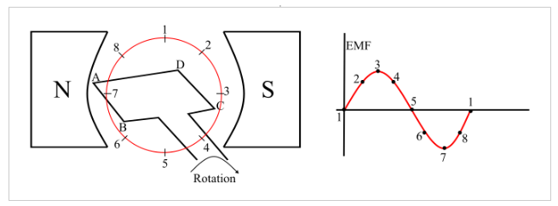
Working principle of DC generator
Consider a single loop DC generator (as shown in the figure), in this a single turn loop ‘ABCD’ is rotating clockwise in a uniform magnetic field with a constant speed.
When the loop rotates, the magnetic flux linking the coil sides ‘AB’ and ‘CD’ changes continuously.
This change in flux linkage induces an EMF in coil sides and the induced EMF in one coil side adds the induced EMF in the other.

Slide 9
The EMF induced in a DC generator can be explained as follows
When the loop is in position-1, the generated EMF is zero because, the movement of coil sides is parallel to the magnetic flux.
When the loop is in position-2, the coil sides are moving at an angle to the magnetic flux and hence, a small EMF is generated.
When the loop is in position-3, the coil sides are moving at right angle to the magnetic flux, therefore the generated EMF is maximum.
When the loop is in position-4, the coil sides are cutting the magnetic flux at an angle, thus a reduced EMF is generated in the coil sides.
When the loop is in position-5, no flux linkage with the coil side and are moving parallel to the magnetic flux. Therefore, no EMF is generated in the coil.
At the position-6, the coil sides move under a pole of opposite polarity and hence the polarity of generated EMF is reversed. The maximum EMF will generate in this direction at position-7 and zero when at position-1.
This cycle repeats with revolution of the coil.

Slide 10
It is clear that the generated EMF in the loop is alternating one.
It is because any coil side (say AB) has EMF in one direction when under the influence of N-pole and in the other direction when under the influence of S-pole.
Hence, when a load is connected across the terminals of the generator, an alternating current will flow through it.
And by using a commutator, this alternating emf generated in the loop can be converted into direct voltage

Slide 11

EMF Equation
Let us suppose there are Z total numbers of conductor in a generator, and arranged in such a manner that all parallel paths are always in series.
Here,
Z = total numbers of conductor
A = number of parallel paths
Then,
Z/A = number of conductors connected in series
We know that induced emf in each path is same across the line
Therefore,
Induced emf of DC generator
e= emf of one conductor × number of conductor connected in series.
A=P for lap type of winding, A= 2 for wave type winding, p= number of poles
Induced emf of DC generator is,

Slide 12
Types of DC Generator
DC generators are classified based on how their fields are excited (i.e. produced). There are three methods of excitation, and thus three main types of DC generators:
Permanent Magnet DC Generators :Field coils excited by permanent magnets
Separately Excited DC Generators : Field coils excited by some external source
Self Excited DC Generators: Field coils excited by the generator itself
Self-excited DC generators can further be classified depending on the position of their field coils. The three types of self-excited DC generators are:
Series Wound Generators
Shunt Wound Generators
Compound Wound Generators

Slide 13
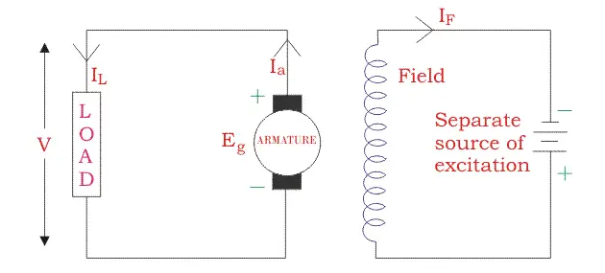
Separately Excited DC Generator
These are the generators whose field magnets are energized by some external DC source, such as a battery.
A circuit diagram of separately excited DC generator is shown in the figure below. The symbols below are:
I_{a} = Armature current
I_{L} = Load current
V = Terminal voltage
E_{g} = Generated EMF

Slide 14



Voltage drop in armature = Ia*Ra
Let,
Then,
Power Generated is equal to,
Power delivered to external load is equal to,

Slide 15
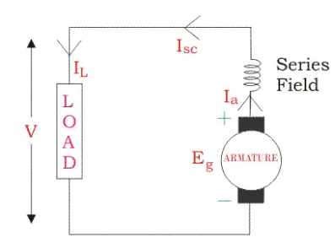
Self Excited DC Generators
Series Wound Generator
In these type of generators, the field windings are connected in series with armature conductors, as shown in the figure below.
Whole current flows through the field coils as well as the load. As series field winding carries full load current it is designed with relatively few turns of thick wire.
Here:
R_{sc} = Series winding resistance
I_{sc} = Current flowing through the series field
R_{a} = Armature resistance
I_{a} = Armature current
I_{L} = Load current
V = Terminal voltage
E_{g} = Generated EMF

Slide 16




Then,
Voltage across the Load is equal to,
Power generated is equal to ,
Power delivered to load,

Slide 17
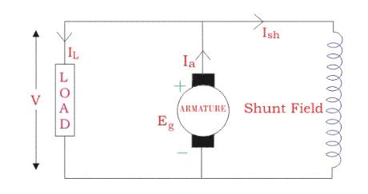
Shunt Wound DC Generators
In these type of DC generators, the field windings are connected in parallel with armature conductors, as shown in the figure below. In shunt wound generators the voltage in the field winding is same as the voltage across the terminal.
Here:
R_{sh} = Shunt winding resistance
I_{sh} = Current flowing through the shunt field
R_{a} = Armature resistance
I_{a} = Armature current
I_{L} = Load current
V = Terminal voltage
E_{g} = Generated EMF

Slide 18





Here armature current I_{a} is dividing in two parts – one is shunt field current I_{sh}, and another is load current I_{L}.
So,
Shunt field current,
Voltage across the load
Power generated is
Power delivered to the load is,

Slide 19
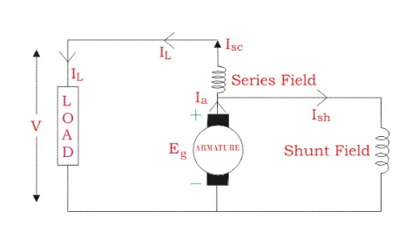
Compound Wound DC Generator
This type of DC generators may be of two types- short shunt compound-wound generator and long shunt compound-wound generator.
Short Shunt Compound Wound DC Generator
Short Shunt Compound Wound DC Generators are generators where only the shunt field winding is in parallel with the armature winding, as shown in the figure below.

Slide 20



Series Field current is,
Shunt field current is,
Armature current is,
Voltage across the load is,
Power generated is,
Power delivered to load is,

Slide 21
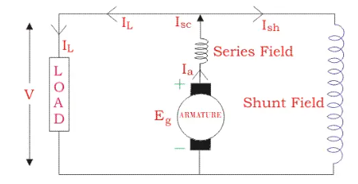
Long Shunt Compound Wound DC Generator
Long Shunt Compound Wound DC Generator are generators where the shunt field winding is in parallel with both series field and armature winding, as shown in the figure below.

Slide 22




Shunt field current,
Armature current,
Voltage across the load is,
Power generated is,
Power delivered is,

Slide 23
DC motor and its working principle
A DC motor is an electromechanical energy conversion device, which converts electrical energy input into the mechanical energy output.
Consider a two pole DC motor. When the DC motor is connected to an external source of DC supply, the field coils are excited developing alternate N and S poles and a current flows through the armature windings.
All the armature conductors under N pole carry current in one direction whereas all the conductors under S pole carry current in the opposite direction.
As each conductor carrying a current is placed in a magnetic field, hence a mechanical force acts on it.
The force on all the conductors add together to exert a torque which make the armature rotating.

Slide 24
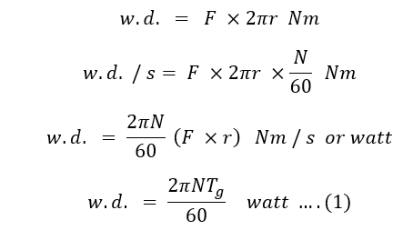
Motor torque
Torque is the tendency of a force to rotate or move an object about an axis.
A force is a push or pull, likewise, torque is a twist to an object. Mathematically, torque, T = F × r.
Let T_{g} = armature or gross torque (N-m) = Force × radius.
r = radius of the armature in m.
N = speed of the armature in rpm = N/60 rps.
Work done/revolution = force × distance moved per revolution

Slide 25
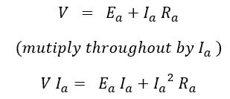

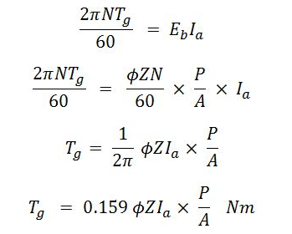
The expression for voltage in dc motor is given by,
Electrical input = electrical power equivalent to mechanical power developed + armature copper loss
Mechanical power developed,
Since equation (1) = equation (2),

Slide 26
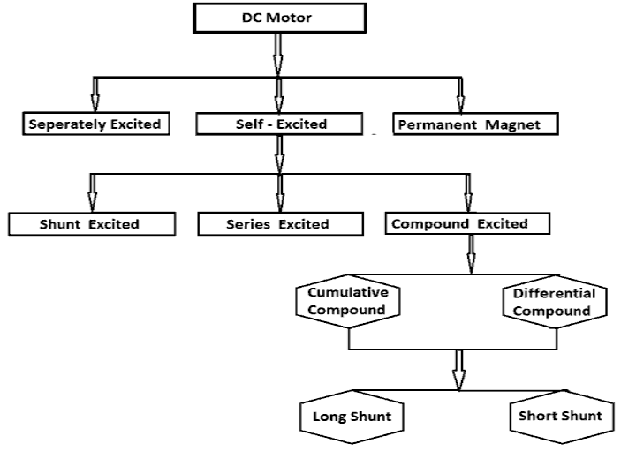
Types of DC motors

Slide 27
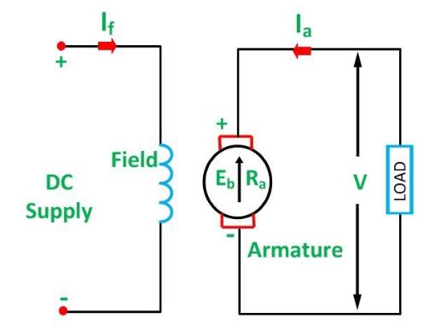
Separately Excited DC Motor
The supply is given separately to the field windings.
The armature current does not flow through the field windings, as the field winding is energized from a separate external source .
We know T_{g} = K_{a} φ I_{a}
So the torque in this case can be varied by varying field flux φ, independent of the armature current I_{a}.

Slide 28
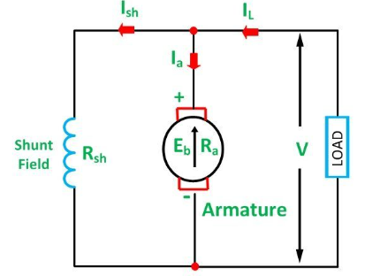

Self Excited DC Motor
In this type of motor, the current in the windings is supplied by the machine or motor itself.
Shunt Wound Motor
This is the most common types of DC Motor. Here the field winding is connected in parallel with the armature.
On applying KCL at the shown junction
Where,
I is the input line current
Ia is the armature current
Ish is the shunt field current
Equation (1) is the current equation.

Slide 29


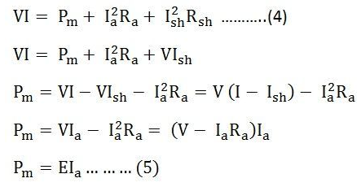
The voltage equations are written by using Kirchhoff’s voltage law (KVL) for the field winding circuit.
For armature winding circuit the equation will be given as:
The power equation is given as:
Power input = mechanical power developed + losses in the armature + loss in the field.

Slide 30

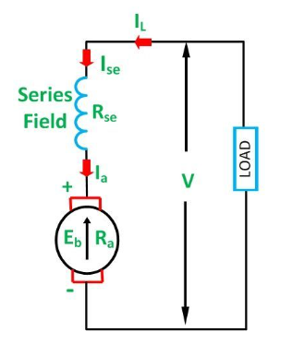
Multiplying equation (3) by Ia we get the following equations.
Where,
VI_{a} is the electrical power supplied to the armature of the motor.
Series Wound Motor
In the series motor, the field winding is connected in series with the armature winding.

Slide 31




By applying the KCL in the above figure:
Where,
I_{se} is the series field current
The voltage equation can be obtained by applying KVL in the above figure.
The power equation is obtained by multiplying equation (8)
Power input = mechanical power developed + losses in the armature + losses in the field
Comparing the equation (9) and (10), we will get the equation shown below

Slide 32
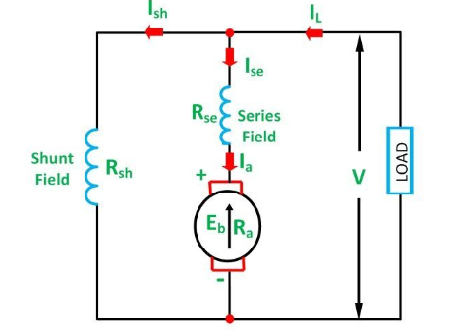
Compound Wound Motor
A DC Motor having both shunt and series field windings is called a Compound Motor.

Slide 33
Speed Of A DC Motor
Back emf “e” of a DC motor is nothing but the induced emf in armature conductors due to rotation of the armature in magnetic field.
Thus, the magnitude of E_{b} can be given by EMF equation of a DC generator.
E_{b} can also be given as,
E_{b} = V- I_{a}R_{a}
thus, from the above equations
N = e 60 A/(P ᶲ Z) but, for a DC motor A, P and Z are constants
Therefore, N ∝ K e/_{Ø} (where, K=constant)
This shows the speed of a dc motor is directly proportional to the back emf and inversely proportional to the flux per pole.

Slide 34
Speed Control Of DC Motor
Flux Control Method:
As the speed of a dc motor is inversely proportional to the flux per pole.
Thus by decreasing the flux, speed can be increased and vice versa.
To control the flux, a rheostat is added in series with the field winding
In case of shunt motors adding more resistance in series with the field winding will increase the speed as it decreases the flux.
Armature Control Method
Speed of a dc motor is directly proportional to the back emf E_{b} and E_{b} = V - I_{a}R_{a}.
when supply voltage V and the armature resistance R_{a} are kept constant, then the speed is directly proportional to armature current I_{a}.
Thus, if resistance is added in series with the armature, I_{a} decreases and, hence, the speed also decreases.
Greater the resistance in series with the armature, greater the decrease in speed.

